Slide 1
ILLiad 8.3
What’s New????
Notes:
How many people are using 8.3?

Slide 2
Fully unicode compliant!
ILLiad is now fully Unicode compliant, supporting Chinese, Japanese, Korean, Hebrew, Arabic, Latin Extended and other non-Western character sets. (Ex. أحَد المُحيطات الخَمْسَه
The Unicode enhancement will approximately double the size of your database. If you are a self-hosted site, make sure you have sufficient local space to accommodate this change.

Slide 3
Automated Overdue Notices
Optional
To turn on or off go to Customization Manager -
System->General ->OverdueNoticesActive (Yes/No Question)
Sends out all Borrowing and Lending overdue notices once per day
Each of the three overdue notices is sent out only once to each borrower so that they are not receiving multiple copies of notices.
To find more information on Automated Overdue notices go to: https://prometheus.atlas-sys.com/display/illiad/Processing+Borrowing+Overdues
Notes:
You will only see transactions in the Overdue screen if the patron or library does not have an e-mail address on file! You can print these overdue notices to send!

Slide 4
E-mail Templates
E-mail templates can now be stored in the Customization Manager
8.3 comes with default borrowing and lending overdue notices
ILLiad will look in the database. Then ILLiad will look in the place you specified in ILLiad under System->E-mail->EMailLocation key, and lastly searches the client relative path(C:\Program Files\ILLiad\Email ).
You can edit, copy or create new e-mails. Right clicking in the window gives you fields for Local Info, Transaction, User, Lender Addresses, and Special
Use Ctrl V when pasting text into the window from another source

Slide 5
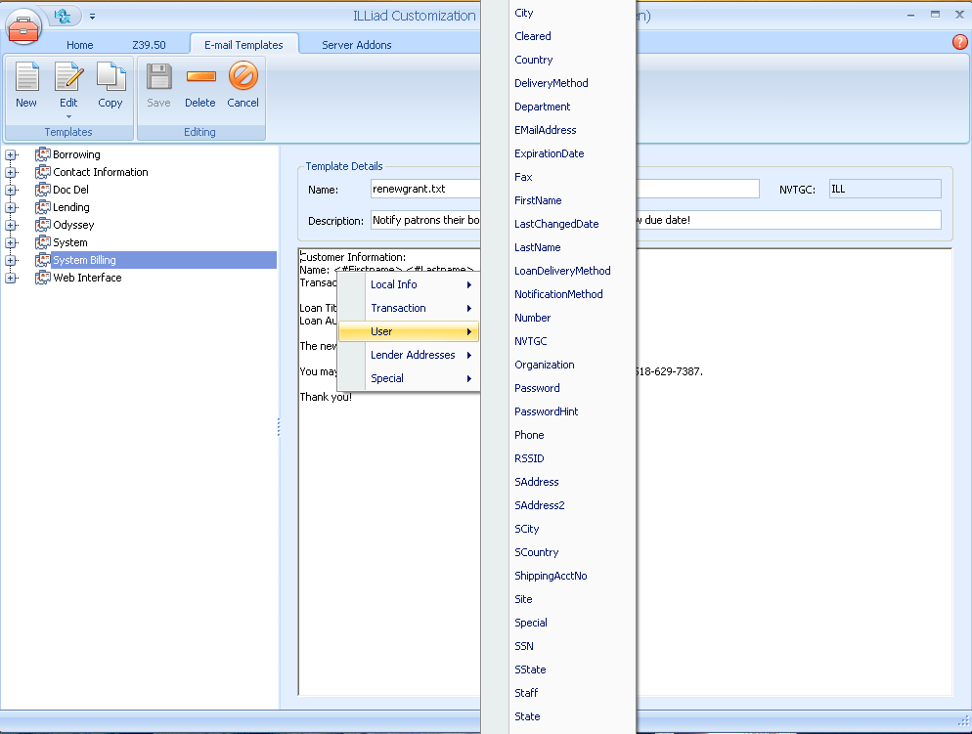

Slide 6
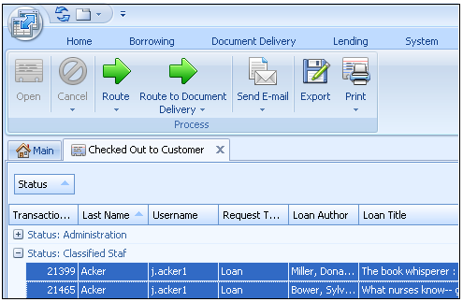
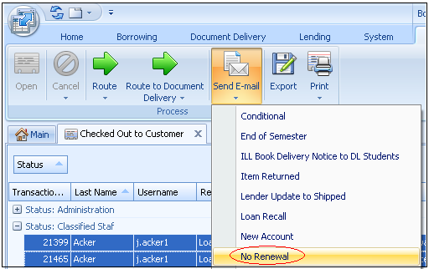
Modified E-mail Routing
Select a group of Transactions
Sends multiple e-mails
Notes:
send email and route requests from locations other than the Request form. I can send two e-mails to this patron about their transactions and not have to go into each transaction.

Slide 7
More new things…
Mobile webpage CSS
New format for request notes (text area)
Addons can use NCIP for seamless circulation workflow

Slide 8
The End
Questions or comments?
https://prometheus.atlas-sys.com/display/illiad/ILLiad+8.3+Release+Notes
Notes:
What new features are you using that I didn’t mention?

